Slide 1


VISVESVARAYA TECHNOLOGICAL UNIVERSITY "JNANA SANGAMA",BELAGAVI-590018
DEPARTMENT OF COMPUTER SCEINCE AND ENGINEERING
PRESENTATION ON
" Person Location Tracking Using Face Recognition "
Presented By
Hemalatha N K : 4HG20CS009
Suprith M S : 4HG20CS028
Vinay N : 4HG20CS033
Nagaraja A S : 4HG21CS416
VISVESVARAYA TECHNOLOGICAL UNIVERSI”, BELAG
Under The Guidence Of
Ms. Keerthana M P
Dr.Raghu.M.E
Dr.K.C.Ravishankar
B.E
Faculty,Dept Of CSE
B.E, M.Tch, Ph.d
Associate Professor, Dept Of CSE
B.E, M.Tch, Ph.d
Professor and Head, Dept Of CSE

Slide 2


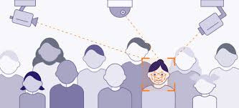


WELCOME
Person Location Tracking Using Face Recognition

Slide 3
Introduction
1
Problem statement
2
Aim and Scope
3
﻿Table Of Contents
Objectives
4
Requirement analysis
5
6
Libraraies and Framework
7
Methodology
Implementation
8
Conclusion
9
Time - Line
10

Slide 4
Introduction
Person location tracking using face recognition is a technology that uses facial recognition to identify and track the location of a specific person in a given environment.
It works by Comparing the known faces trained to the model with real time video footage from cameras.
When a match is found, the system can track the person’s location and report their location to the user.

Slide 5

Problem statement
The challenge lies in the time-consuming and manpower-intensive process of physically locating individuals, particularly during emergency situations where swift identification is crucial.

Slide 6
Aim and Scope
Aim:
The aim of person location tracking using face recognition is to use
facial recognition technology to identify and track the location of a specific
person in a given environment.
Scope:
Implement real-time processing for swift analysis of facial features.
Ensure ethical data use, user-friendly interface, and scalability for diverse situations.

Slide 7
Objectives
Locating Students : Identifying and locating students within educational institutions, enabling efficient and immediate response to emergency situations,
Security : Face recognition can be used to track the movements of unauthorized individuals in secure areas, such as educational institutions and.

Slide 8
Requirement analysis
Hardware Requirements | Hardware Requirements
Processor | Intel/AMD/others(1.5GHz or above)
RAM | 4GB or more
Hard disk | 100GB or more
Software Requirements | Software Requirements
Operating system | Windows /Linux /MAC /others
Coding Language | Python
Editor | Vs code /Pycharm /others
Libraries | Opencv, Pandas, dlib,Tensorflow

Slide 9
Methodology
The methodology for person location tracking using face recognition can be divided into the following steps:
Data collection : Data collection involves gathering of unique ID, name and images in a systematic and organized manner
Model Training: Model training is the process of teaching a machine learning algorithm to recognize patterns and make predictions by feeding it images as data.

Slide 10
Analysis video from camera: Recognizing face from the input video stream using the trained machine.
Data storing : storing the information of the camera location where the recognized person present in the video into the Excel sheet/database.
Search: searching required person's location by entering his unique id.
Location reporting: displaying the location of the person, by fetching the location details from the Excel/database if found, else display not found.

Slide 11
Libraries and Framework
Flask: Flask is a micro web framework written in Python. It's used here to create the web application that serves the attendance management system.
OpenCV (cv2): OpenCV is a popular library for computer vision tasks. It's used extensively for capturing video frames, resizing frames, drawing rectangles and text on frames, and displaying frames.
face_recognition: The face_recognition library is built on top of dlib and is used for face recognition tasks. It's employed here to recognize faces in the video stream. The library utilizes the HOG (Histogram of Oriented Gradients) algorithm for face detection and the dlib library for face recognition.

Slide 12
Libraries and Framework
MySQL Connector (mysql.connector) : This library is used to establish a connection to the MySQL database where student and attendance data are stored.
Threading: Threading is utilized to process video streams from multiple cameras concurrently. This allows the system to recognize faces and log attendance simultaneously from different camera sources.
Datetime (datetime) : The datetime module is used for handling date and time information. It's employed here to manage timestamps for attendance logging and to define recognition and rest periods.

Slide 13
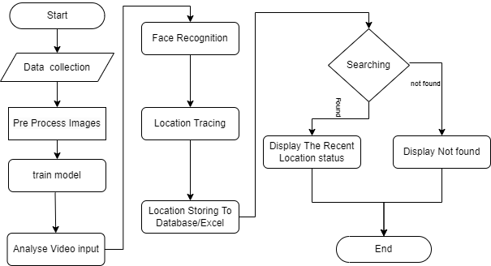
Data flow diagram

Slide 14
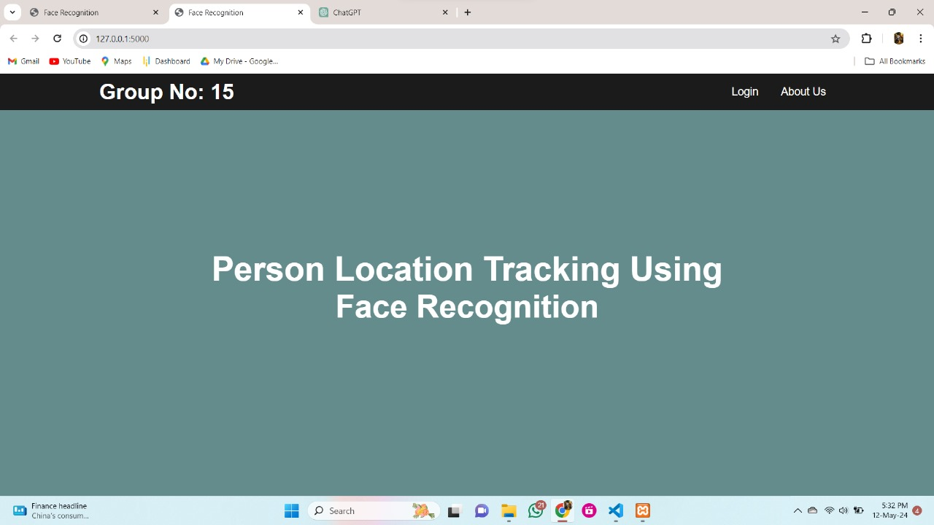
Implementation
Fig: Home page

Slide 15
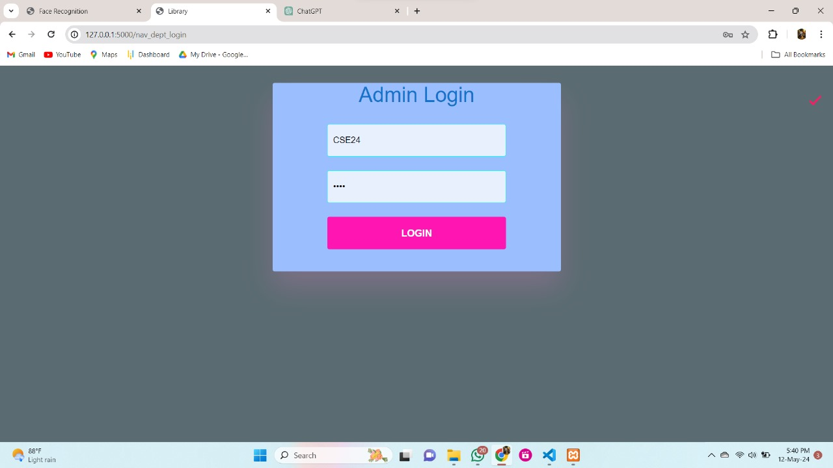
Implementation
Fig: Login page

Slide 16
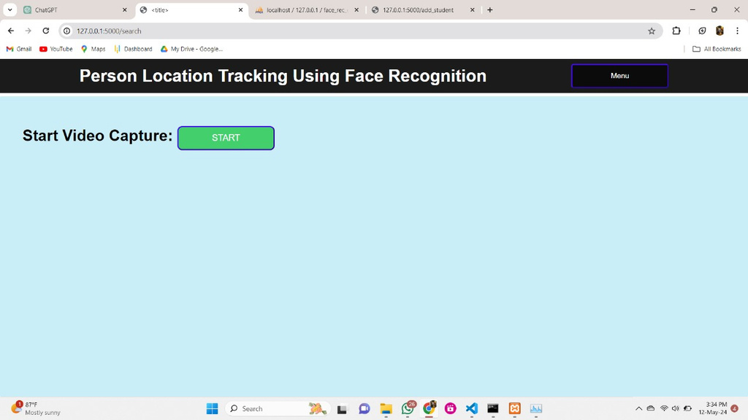
Conti...
Fig: Video Capture Page

Slide 17
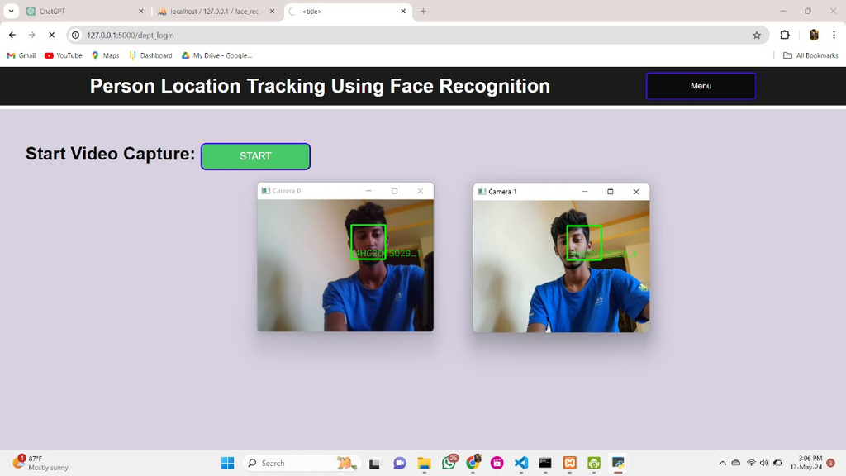
Conti...
Fig: Video Recognising

Slide 18
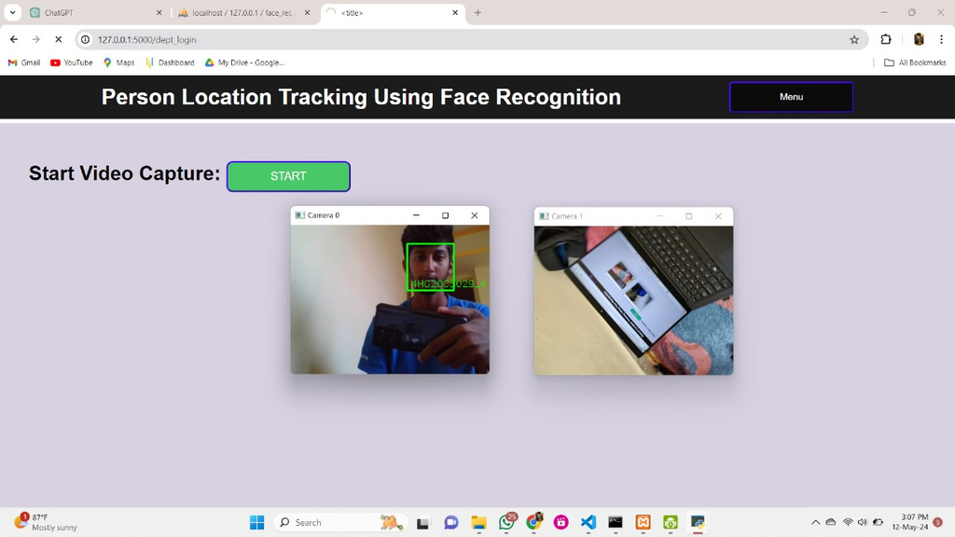
conti...
Fig: Multiple camera input

Slide 19
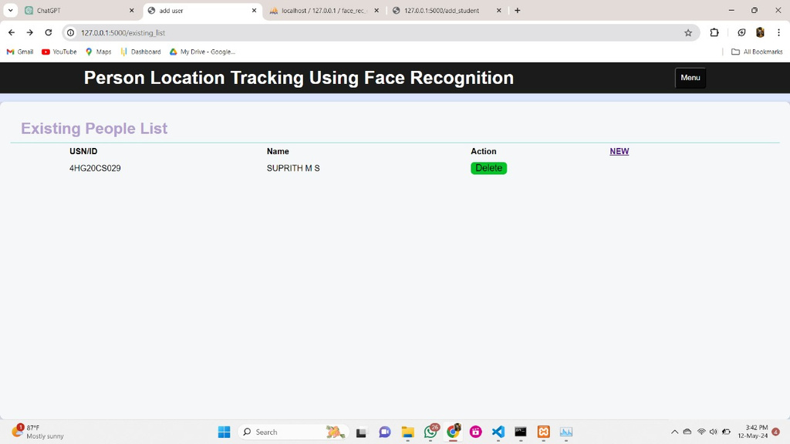
conti...
Fig: showing existing Details

Slide 20
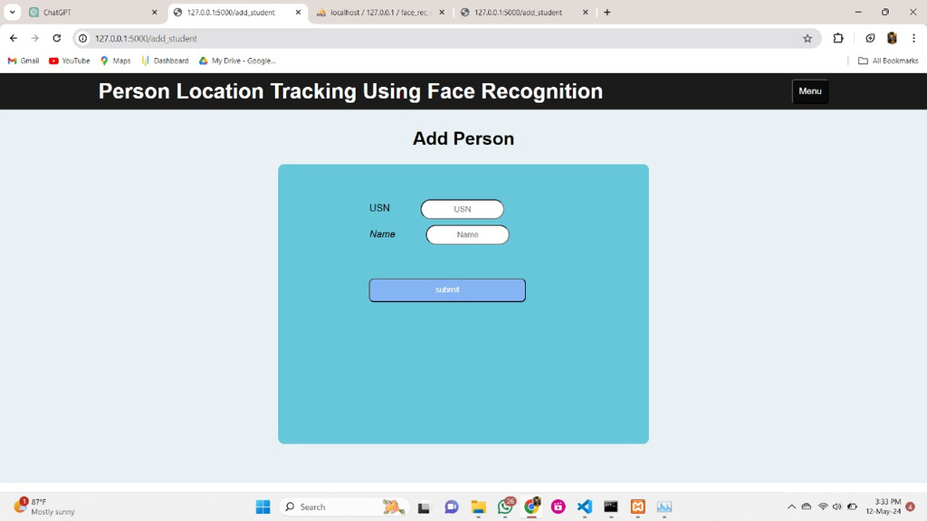
conti...
Fig: Adding new person

Slide 21
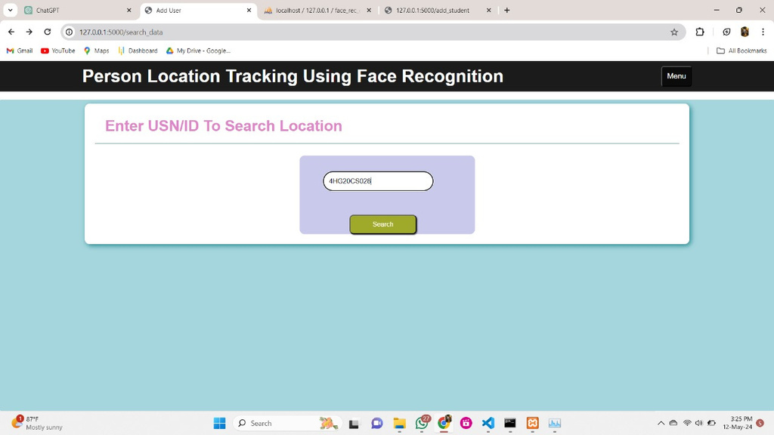
conti...
Fig:Searching location using Usn/id

Slide 22
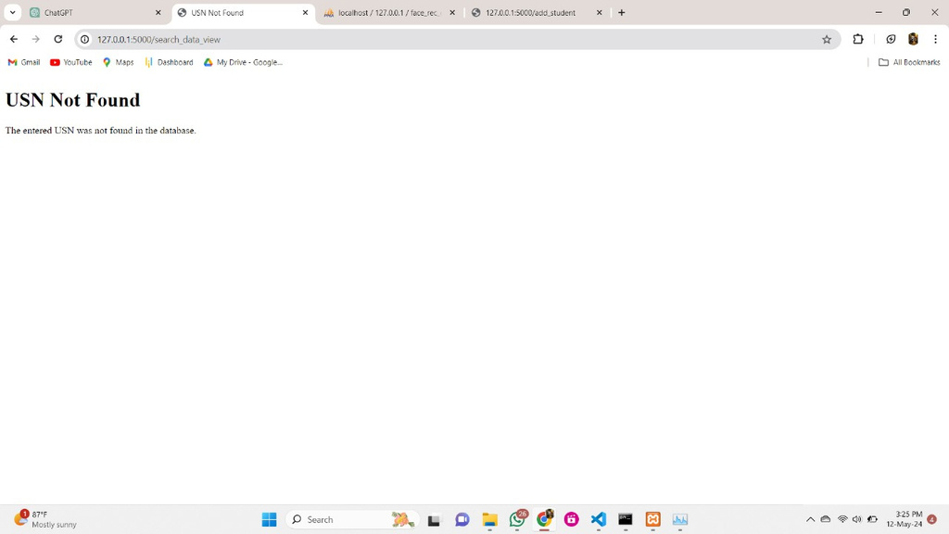
conti...
Fig: If usn not in data base

Slide 23
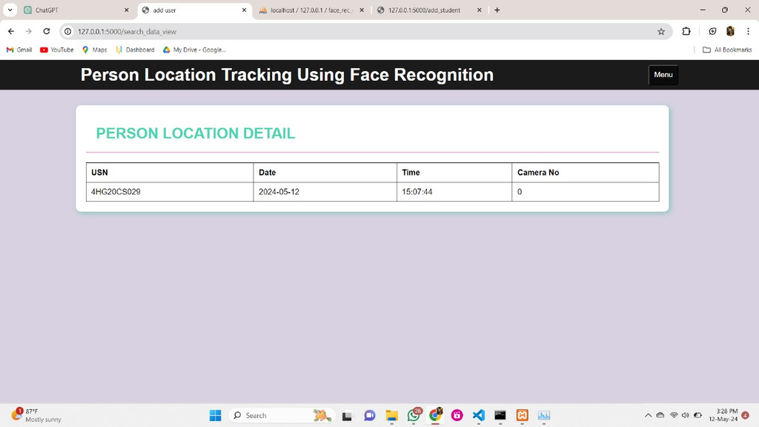
conti...
Fig: Found result displaying

Slide 24
CONCLUSION
A Person Location Tracking System Using Face Recognition technology offers a powerful solution for various applications. By accurately identifying individuals in real-time, it enhances security measures, facilitates efficient attendance management, and enables personalized services. However, ethical considerations regarding privacy and data security must be rigorously addressed to ensure the responsible deployment and use of such systems.

Slide 25
Time-Line
TASKS | FROM DATE | COMPLETION
Requirements Gathering and Analysis | 3ʰ October 2023 | 17ᵗʰ November 2023
Design and Architecture | 25ᵗʰ November 2023 | 25ᵗʰ December 2023
Implementation and Coding | 31ᵗʰ December 2023 | 28ᵗʰ January 2024
Testing and Deployment | 30ˢᵗ January 2024 | 28ᵗʰ February 2024
Maintenance and Support | 29ˢᵗ February 2024 | 14ᵗʰ March 2024
Documentation and Finalization | 15ᵗʰ March 2024 | 14ᵗʰ May 2024

Slide 26
﻿THANK YOU

